Slide 1
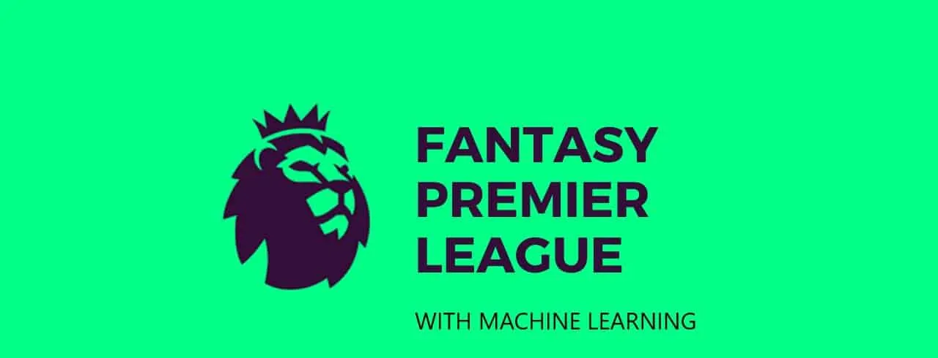
Optimizing Fantasy Premier League Strategies: A Machine Learning Approach
Group 3 - Team Members:
Naishal Shah
Yashwi Passary
Date: 12/10/2024

Slide 2
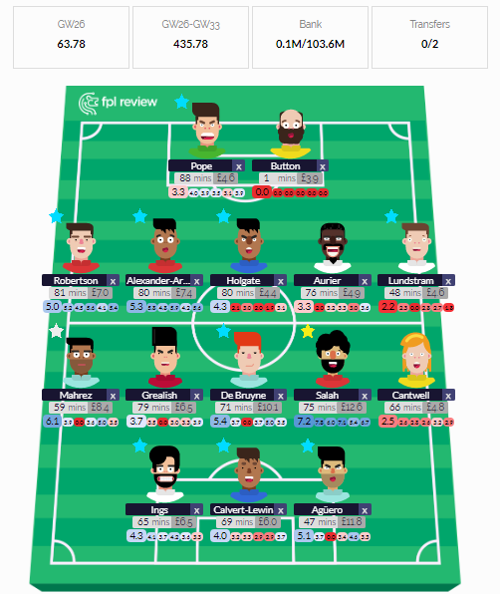
Introduction to FPL Strategies
In this presentation, we explore optimizing Fantasy Premier League (FPL) strategies using a machine learning approach. The goal is to enhance decision-making for FPL managers by analyzing player data, match statistics, and team dynamics.
By leveraging predictive analytics, we aim to maximize points potential and improve overall team performance throughout the season.

Slide 3
To implement machine learning in Fantasy Premier League (FPL), we gathered relevant player statistics, match results, and Gameweek reports from GitHub and the official site of Fantasy Premier League. We merged data from all seasons into a comprehensive dataset, which we then cleaned and preprocessed for use in predictive models.
The steps included:
Removing null values and updating missing player positions.
Filtering players who are still active this season and removing those no longer playing.
Assigning team names based on previous data.
Key Strategies for Success:
Budget Management: A £100.0m budget to pick 15 players (2 goalkeepers, 5 defenders, 5 midfielders, 3 forwards).
Team Composition: Select 11 playing players each week, with specific requirements for positions and bench setup.
Player Selection: Avoid selecting the same player more than once and limit the number of players from each team.
Captaincy: Choose a captain whose points are doubled for the week.
Transfers: One free transfer per week; additional transfers incur point deductions.
Data Cleaning and Preparation

Slide 4

Model Training Evaluation
Machine Learning Algorithms Used: To enhance FPL strategy, we utilize machine learning models for:
Captaincy Selection: Predicting the best captain for each game week based on player performance, fixture difficulty, and other factors. We have used Random Forest to predict the Captains and Vice Captains.
Fixture Difficulty Ratings (FDR): Estimating the difficulty of upcoming fixtures for teams, considering dynamic factors like player form and opponent strength. We have used Random Forest again to determine the FDRs. Additionally, we have implemented Reinforcement Learning, but it has not provided optimal results yet, and we are working on optimizing the model further.

Slide 5
1. Captaincy Prediction
For predicting Fantasy Premier League (FPL) captaincy decisions, we used a Random Forest Regressor model. The goal is to predict the total points for players based on a set of features and then select the captain and vice-captain for each game week based on these predictions.
Instead of relying on rigid rules, we evaluate captain predictions in the context of:
Gameweek Performance: Assess how well the predicted captain performs relative to other players based on features like form, bonus points (bps), goals scored, influence on the game, threat, clean sheets, and more.
Vice-Captain as Backup: If the captain does not play a single minute of the game, the vice-captain assumes the captaincy role, earning the team double points. This ensures that the model accounts for contingencies in player availability.

Slide 6
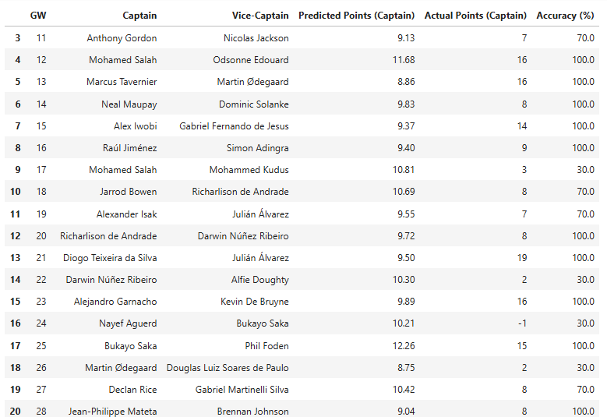

Slide 7
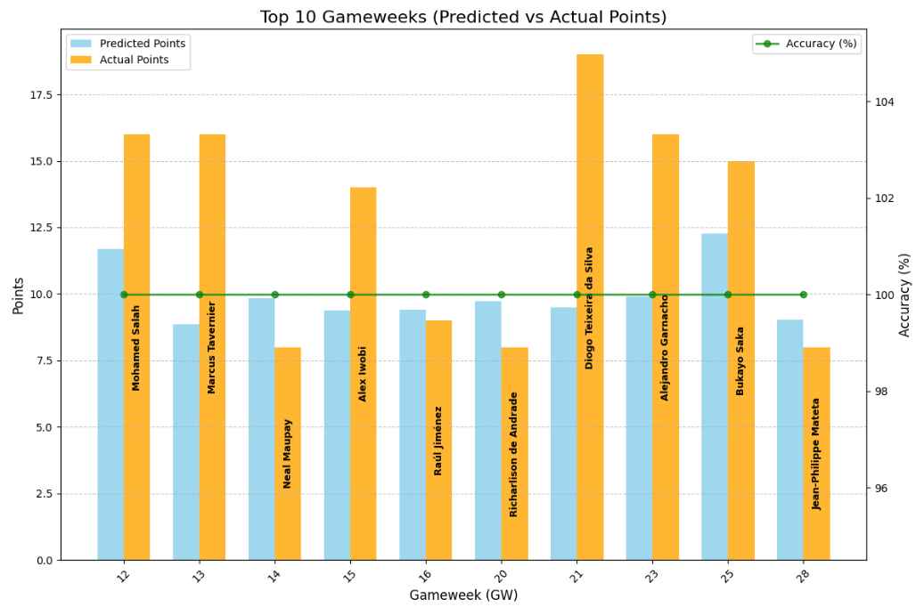
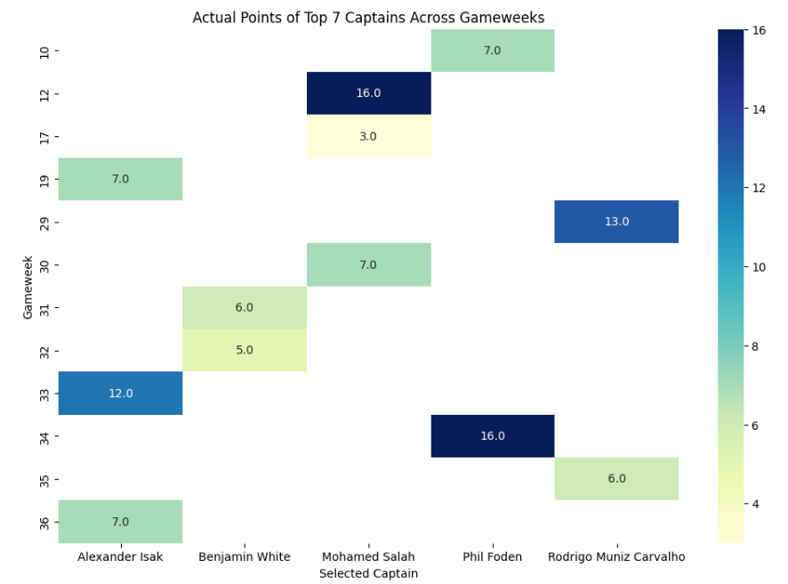

Slide 8
2. Fixture Difficulty Rating (FDR) Prediction
With our Dynamic Fixture Difficulty Rating (FDR) model, we assess the relative difficulty of football fixtures for each team, accounting for factors such as current form, win streak, goal differences and historical performance. This model evolves over the season, adjusting based on team performances and match outcomes.
Instead of relying on static ratings, we evaluate the FDR with:
Team Performance Adjustments: Continuously refine fixture difficulty based on changing team dynamics, like team performance and current form.
Opponent Strength: Factor in the relative strength of the opposing team in the fixture, considering both home and away performance.
Predictive Insights: Use the FDR to anticipate which fixtures are most favorable, optimizing team selections and strategy.

Slide 9
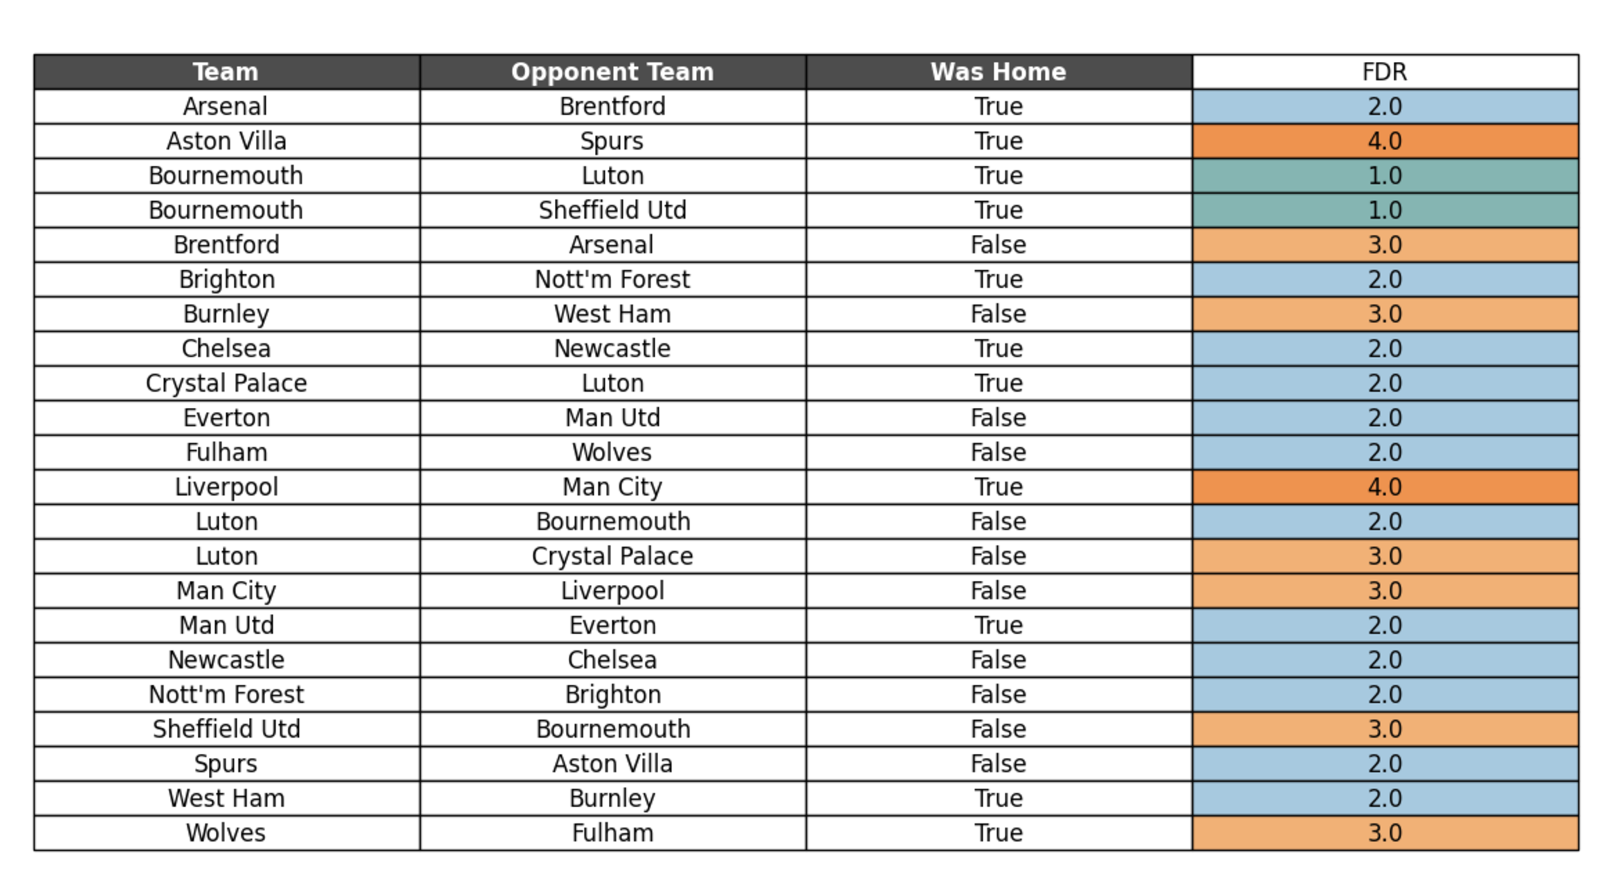
GW 28: FDR Table with Highlighted Column

Slide 10
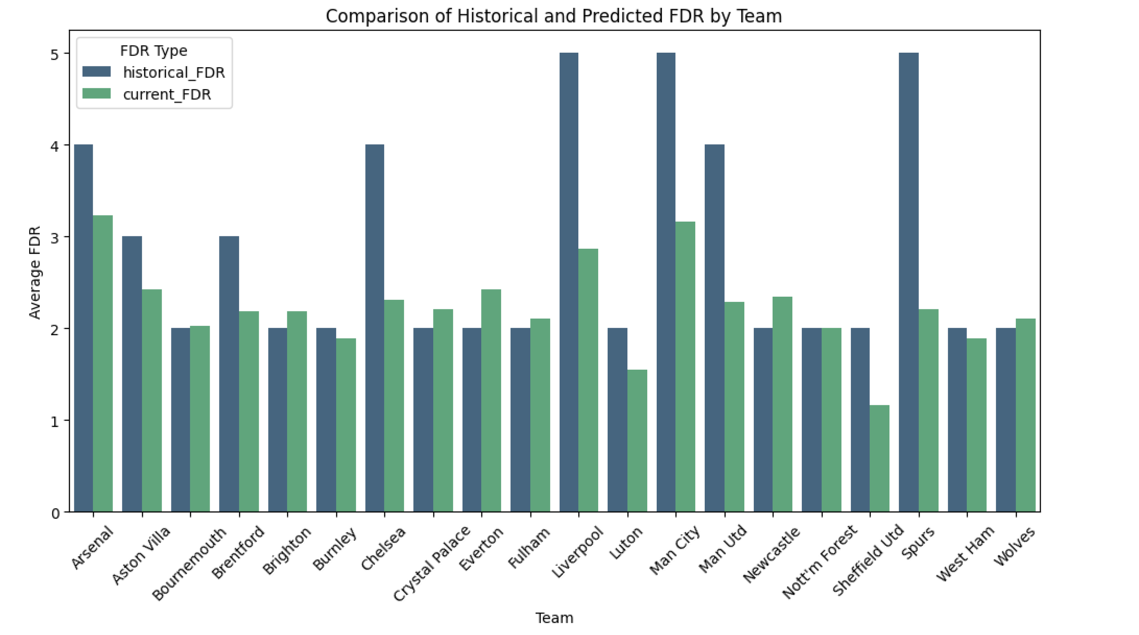
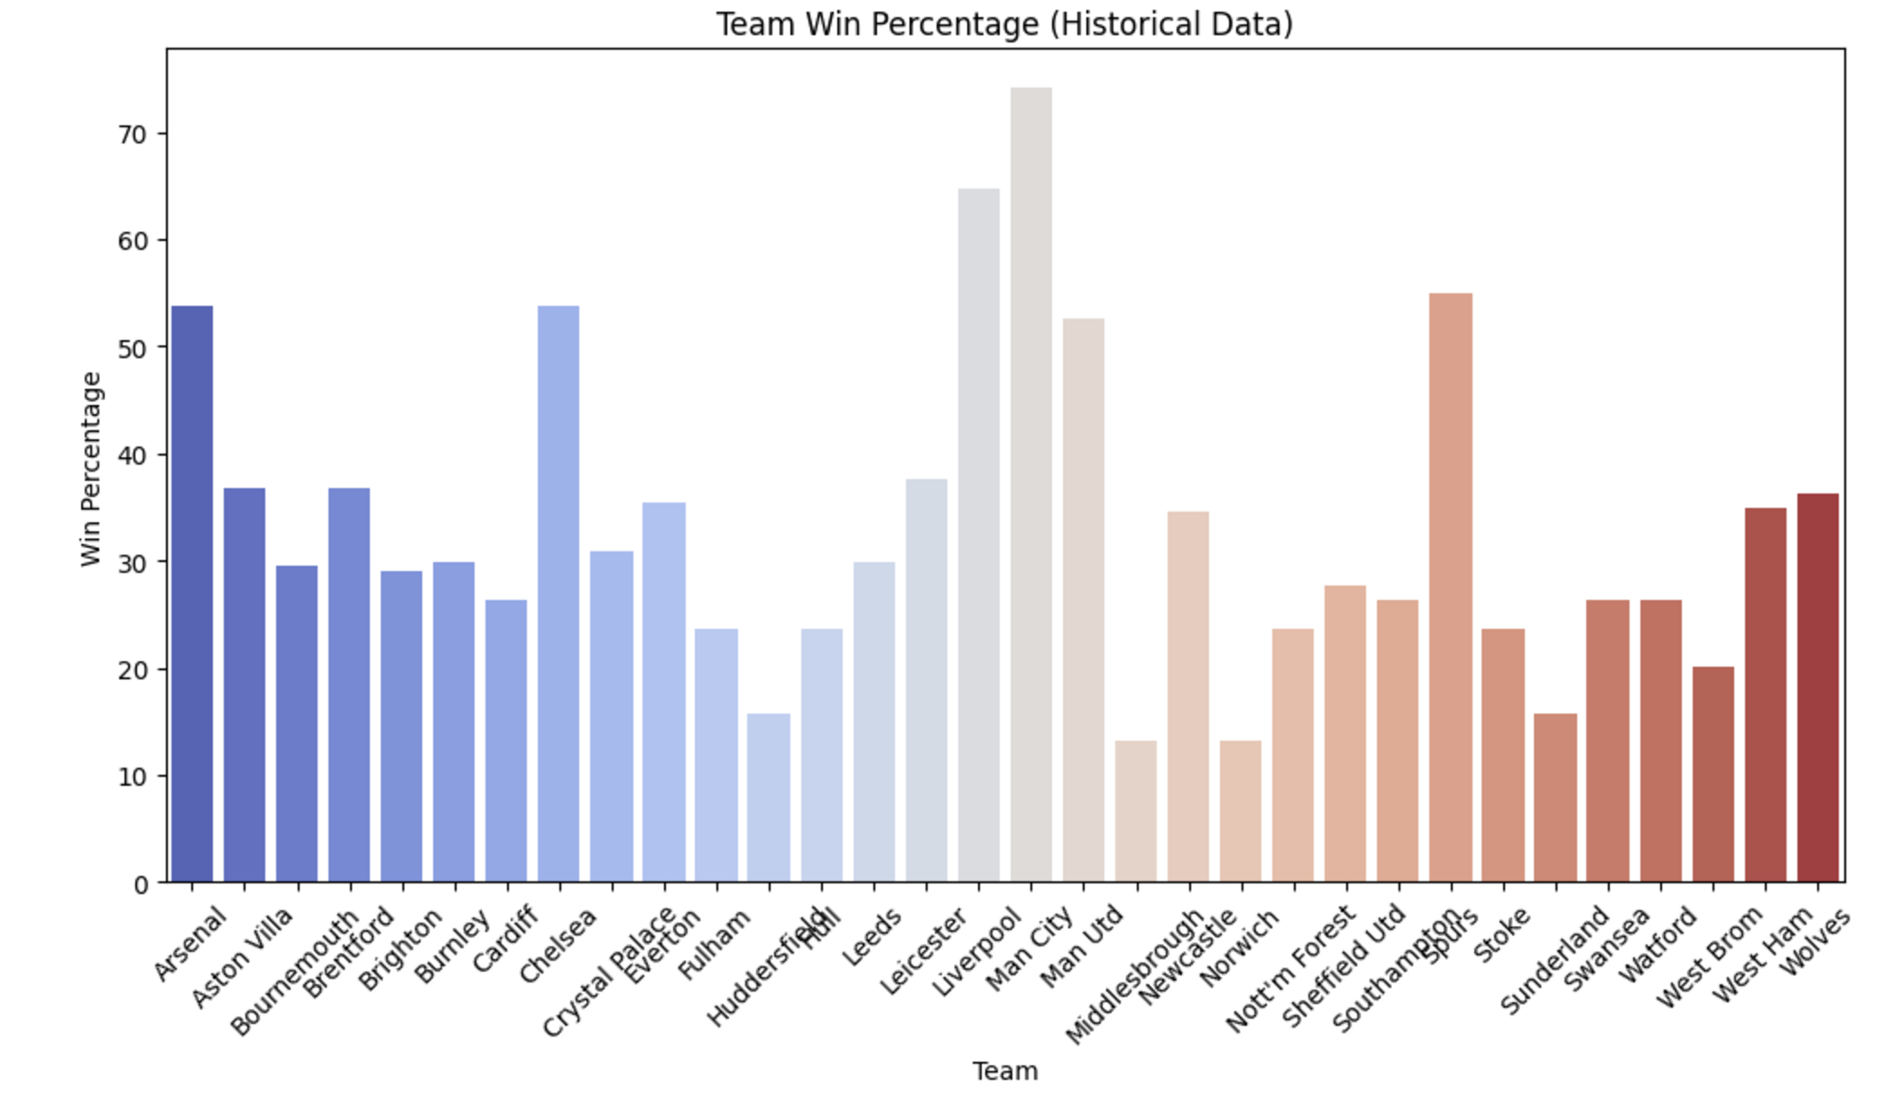

Slide 11
Future Work
Implement FDR Using Reinforcement Learning: We will focus on enhancing the implementation of Fixture Difficulty Ratings (FDR) using Reinforcement Learning. The aim is to optimize the model further to better capture dynamic factors, such as team form, injuries, and match outcomes, thereby improving prediction accuracy.
Wildcard Team Prediction for Each Game Week: We plan to develop a model that predicts the optimal wildcard team for each game week. This will assist fantasy managers in making informed decisions about when to use their wildcard, selecting the best possible players based on upcoming fixtures, player form, and other key metrics.
Improve Accuracy for Captaincy Prediction: We will work on refining the Random Forest Regressor model for captaincy prediction. By incorporating additional features and optimizing the model, we aim to enhance the accuracy of predicting the best captain and vice-captain for each game week.

Slide 12
Thank You

